Slide 1
Spring / FORWARD
Possible Integration

Slide 2
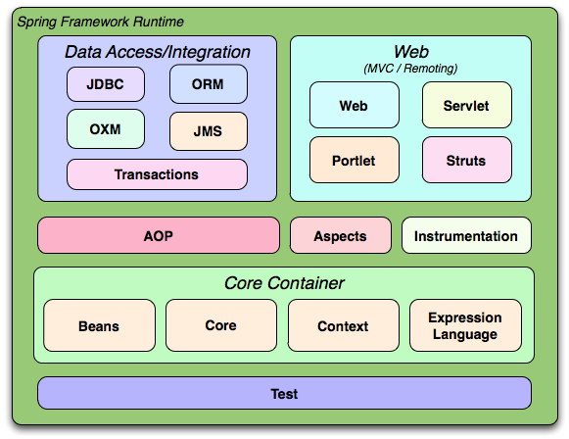
Architecture
Spring can be used in standard applications, web applications, full Java EE applications, and other containers.

Slide 3
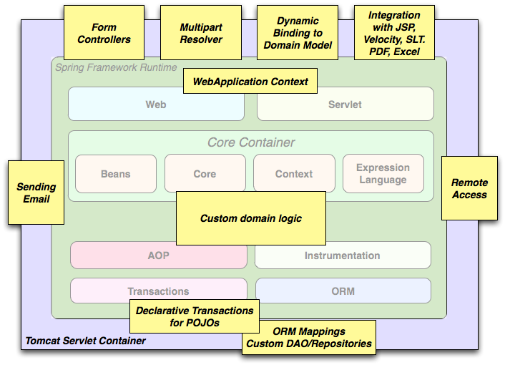
Typical full-fledged Spring web application

Slide 4
Typical full-fledged Spring web application
Spring's declarative transaction management features make the web application fully transactional, just as it would be if you used EJB container-managed transactions.
Form controllers seamlessly integrate the web-layer with the domain model, removing the need for ActionForms or other classes that transform HTTP parameters to values for your domain model.

Slide 5
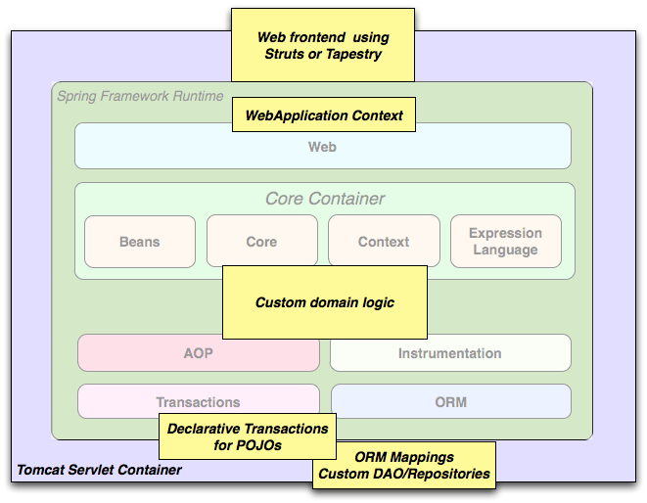
Spring middle-tier using a third-party web framework
Integrating a Struts web tier within a Spring application is deprecated as of Spring 3.0

Slide 6
Spring middle-tier using a third-party web framework
You simply need to wire up your business logic using an ApplicationContext and use a WebApplicationContext to integrate your web layer.

Slide 7
Inversion of Control (IoC) or Dependency Injection (DI)
A process whereby objects define their dependencies, that is, the other objects they work with, only through constructor arguments, arguments to a factory method, or properties that are set on the object instance after it is constructed or returned from a factory method.
The container then injects those dependencies when it creates the bean. This process is fundamentally the inverse of the bean itself controlling the instantiation or location of its dependencies by using direct construction of classes, or a mechanism such as the Service Locator pattern.

Slide 8
Inversion of Control (IoC) or Dependency Injection (DI) (cont’d)
Aims to make your code more manageable, more testable, and more portable.
Aspects of Spring IoC resemble and include the Factory and Observer patterns.
Types of dependency injection:
Constructor Injection
Setter Injection (most common)
Interface Injection (not used)

Slide 9
Non-DI Example
public class VotingBooth {
VoteRecorder voteRecorder = new VoteRecorder();
public void vote(Candidate candidate) {
voteRecorder.record(candidate);
}
class VoteRecorder {
Map hVotes = new HashMap();
public void record(Candidate candidate) {
int count = 0;
if (!hVotes.containsKey(candidate)) hVotes.put(candidate, count);
else count = hVotes.get(candidate);
count++;
hVotes.put(candidate, count);
}
}
}

Slide 10
Non-DI Example (cont’d)
Rigidity
It is hard to change because every change affects too many other parts of the system
Fragility
When you make a change, unexpected parts of the system break
Immobility
It is hard to reuse in another application because it cannot be disentangled from the current application

Slide 11
DI Example
public interface VoteRecorder {
public void record(Candidate candidate) ;
}
public class LocalVoteRecorder implements VoteRecorder {
Map hVotes = new HashMap();
public void record(Candidate candidate) {
int count = 0;
if (!hVotes.containsKey(candidate)) hVotes.put(candidate, count);
else count = hVotes.get(candidate);
count++;
hVotes.put(candidate, count);
}
}

Slide 12
DI Example (cont’d)
public class VotingBooth {
VoteRecorder recorder = null;
public void setVoteRecorder(VoteRecorder recorder) {
this.recorder = recorder;
}
public void vote(Candidate candidate) {
recorder.record(candidate);
}
}
How instantiates LocalVoteRecorder? Spring does and injectes it into VotingBooth!

Slide 13
Spring IoC container
Through Spring IoC container, you can configure the number of instances of the component and at what point the component is created and destroyed in memory.
Once instantiated, Spring IoC manages the scope of the bean, based on its configuration.

Slide 14
Example Configuration
<beans namespaces>
<bean id="recorder" class="com.springindepth.LocalVoteRecorder" />
<bean id="votingBooth" class="com.springindepth.VotingBooth">
<property name="voteRecorder" ref="recorder"/>
<constructor-arg ref="recorder" />
</bean>
</beans>

Slide 15
Example Application
public class VotingBoothRunner {
final static Logger logger = LoggerFactory.getLogger(VotingBoothRunner.class);
public static void main(String[] args) {
logger.info("Initializing Spring context.");
ApplicationContext applicationContext =
new ClassPathXmlApplicationContext("/application-context.xml");
logger.info("Spring context initialized.");
VotingBooth booth = applicationContext.getBean("votingBooth”, VotingBooth.class);
}
}

Slide 16
Bean configuration
class
id, name(s)
scope
constructor arguments
properties
autowiring mode
lazy-initialization mode
initialization method
destruction method
Can be specified via XML, Java code or annotations

Slide 17
Bean scopes
singleton
prototype
custom (thread)
Only valid in the context of a web-aware ApplicationContext
request
session
globalSession (for portlet-based web applications)

Slide 18
Scoped beans as dependencies
<beans even more namespaces>
<!-- an HTTP Session-scoped bean exposed as a proxy -->
<bean id="userPreferences" class="com.foo.UserPreferences" scope="session">
<!-- instructs the container to proxy the surrounding bean -->
<aop:scoped-proxy/>
</bean>
<!-- a singleton-scoped bean injected with a proxy to the above bean -->
<bean id="userService" class="com.foo.SimpleUserService">
<!-- a reference to the proxied userPreferences bean -->
<property name="userPreferences" ref="userPreferences"/>
</bean>
</beans>

Slide 19
Spring’s Own Web MVC
Reusable business code No need for duplication or interface implementation. Use existing business objects as command or form objects instead of mirroring them to extend a particular framework base class.
Customizable binding and validation Spring treats type mismatches as validation errors. Thus you need not duplicate your business objects' properties as untyped strings in your form objects simply to handle invalid submissions, or to convert the strings properly. Instead, it is often preferable to bind directly to your business objects.

Slide 20
Spring’s Own Web MVC (cont’d)
Flexible model transfer Model transfer with a name/value Map supports easy integration with any view technology.
Customizable handler mapping and view resolution Handler mapping and view resolution strategies range from simple URL-based configuration, to sophisticated, purpose-built resolution strategies. Spring is more flexible than web MVC frameworks that mandate a particular technique.
Customizable locale and theme resolution Support for JSPs with or without Spring tag library, support for JSTL, support for Velocity.
Pluggability of other MVC implementations

Slide 21
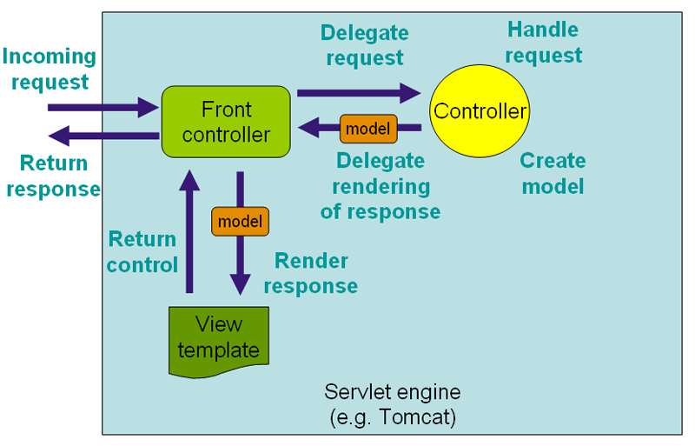
DispatcherServlet Front Controller design pattern

Slide 22
DispatcherServlet (cont’d)
web.xml
<servlet>
<servlet-name>example</servlet-name>
<servlet-class>org.springframework.web.servlet.DispatcherServlet</servlet-class>
<load-on-startup>1</load-on-startup>
</servlet>
<servlet-mapping>
<servlet-name>example</servlet-name>
<url-pattern>/example/*</url-pattern>
</servlet-mapping>
Spring MVC looks for a file named example-servlet.xml in the WEB-INF directory of your web application and creates the beans defined there.

Slide 23
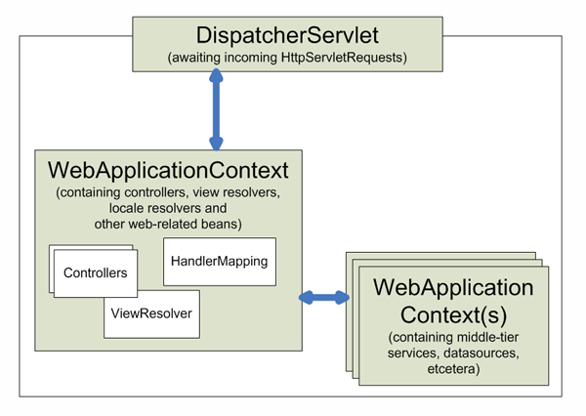
DispatcherServlet (cont’d)
The WebApplicationContext is bound in the request as an attribute that the controller and other elements in the process can use.

Slide 24
Special bean types in WebApplicationContext
HandlerMapping Maps incoming requests to handlers. If a handler is found, the execution chain associated with the handler (preprocessors, postprocessors, and controllers) is executed in order to prepare a model or rendering.
HandlerExceptionResolver Maps exceptions to views also allowing for more complex exception handling code.
ViewResolver Resolves logical String-based view names to actual View types.
FlashMapManager Stores and retrieves the "input" and the "output" FlashMap that can be used to pass attributes from one request to another, usually across a redirect.

Slide 25
Controllers
@Controller
public class HelloWorldController {
@RequestMapping("/helloWorld")
public String helloWorld(Model model) {
model.addAttribute("message", "Hello World!");
return "helloWorld";
}
}
View Name

Slide 26
Controllers (cont’d)
Supported method return types
A ModelAndView object, with the model implicitly enriched with command objects and the results of @ModelAttribute annotated reference data accessor methods.
A Model object, or a Map object for exposing a model, with the view name implicitly determined through a RequestToViewNameTranslator and the model implicitly enriched with command objects and the results of @ModelAttribute annotated reference data accessor methods.
A View object, with the model implicitly determined through command objects and @ModelAttribute annotated reference data accessor methods.

Slide 27
Models
// Add one attribute
// The return value is added to the model under key "account”
@ModelAttribute
public Account addAccount(@RequestParam String number) {
return accountManager.findAccount(number);
}
// Add multiple attributes
@ModelAttribute
public void populateModel(@RequestParam String number, Model model) {
model.addAttribute(accountManager.findAccount(number));
// add more ...
}
A controller can have any number of @ModelAttribute methods that are invoked before the @RequestMapping methods.

Slide 28
Views
Out of the box, Spring enables you to use JSPs, Velocity templates and XSLT views.
ViewResolver provides a mapping between view names and actual views.
View interface addresses the preparation of the request and hands the request over to one of the view technologies.
<bean id="viewResolver”
class="org.springframework.web.servlet.view.UrlBasedViewResolver">
<property name="viewClass" value="org.springframework.web.servlet.view.JstlView"/>
<property name="prefix" value="/WEB-INF/jsp/"/>
<property name="suffix" value=".jsp"/>
</bean>

Slide 29
Spring / Servlet Containers
Start up a Spring root application context through its ContextLoaderListener, and access it through its ServletContext attribute from within a Struts action.
No "plug-ins" are involved, so no dedicated integration is necessary. From the web layer's point of view, you simply use Spring as a library, with the root application context instance as the entry point.

Slide 30
Spring / Servlet Containers (cont’d)
ApplicationContext instantiation in web.xml
<context-param>
<param-name>contextConfigLocation</param-name>
<param-value>/WEB-INF/daoContext.xml /WEB-INF/applicationContext.xml</param-value>
</context-param>
<listener>
<listener-class>org.springframework.web.context.ContextLoaderListener</listener-class>
</listener>
One can use the following code snippet to get access to the ApplicationContext created by the ContextLoaderListener.
WebApplicationContext ctx = WebApplicationContextUtils.getWebApplicationContext(servletContext);

Slide 31
Spring / Servlet Containers (cont’d)
Struts Integration
public class UserAction extends DispatchActionSupport {
public ActionForward execute(ActionMapping mapping,
ActionForm form,
HttpServletRequest request,
HttpServletResponse response) throws Exception {
WebApplicationContext ctx = getWebApplicationContext();
UserManager mgr = (UserManager) ctx.getBean("userManager");
// talk to manager for business logic
return mapping.findForward("success");
}
}

Slide 32
Spring / FORWARD
Integration can happen in two levels
Integrate with Spring IoC container only and use FORWARD’s servlets to serve requests
Integrate with Spring Web MVC and use Spring’s DispatcherServlet to serve requests
controllers are written in Java and models use ORMs
FORWARD is simply the view

Slide 33
Spring / FORWARD 1
Reports
Spring IoC container becomes the UAS
Read Java POJOs and covert to SQL++ values
Forms
Convert SQL++ values to Java POJOs and add them to the ApplicationContext if needed

Slide 34
Spring / FORWARD 2
Reports
Spring IoC container becomes the UAS
Read Java POJOs and covert to SQL++ values
Implement a custom ViewResolver

Slide 35
Spring / FORWARD 2 (cont’d)
Forms
Spring IoC container can be extended by plugging in implementations of special integration interfaces
Convert SQL++ values to Java POJOs and add them to the ApplicationContext by implementing the WebArgumentResolver extension point
This Java class construction needs to be done during compilation in order to have a complete Spring configuration
Not clear how to handle data binding and validation

Slide 36
Not Covered
Validation, Data Binding, and Type Conversion
Spring Expression Language (SpEL)
Aspect Oriented Programming with Spring
Data Access
Spring Web Flow
Spring Mobile
Spring Security

Slide 37
References
Spring Framework Reference Documentation http://static.springsource.org/spring/docs/3.1.x/spring-framework-reference/html/
Spring By Example http://www.springbyexample.org/

